Slide 1
Unit 4 For Live Session Assignment
Isabella Westlauer
1/26/2026

Slide 2
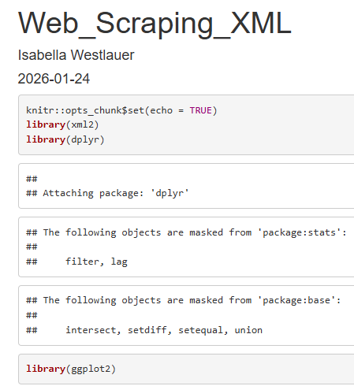
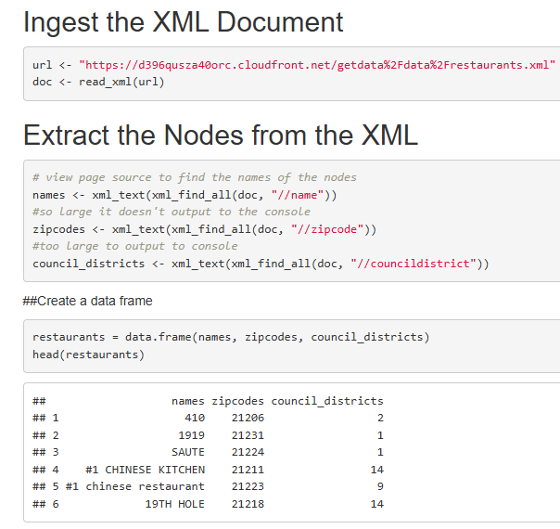
Scrape the XML page for name, zipcode and city council district. (Use either the XML or rvest package.)

Slide 3
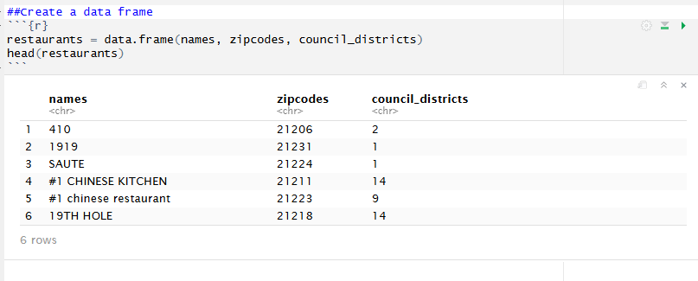
Make a dataframe with just those columns.

Slide 4
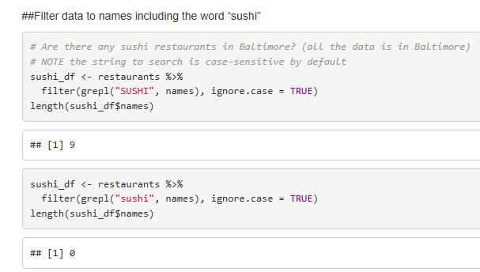
Are there any Sushi restaurants in Baltimore? (Where the dataset is from.)
There are 9 restaurant names in the xml, containing the word “sushi” but searching for “sushi” returns no results. Why does ignore.case not work here?

Slide 5
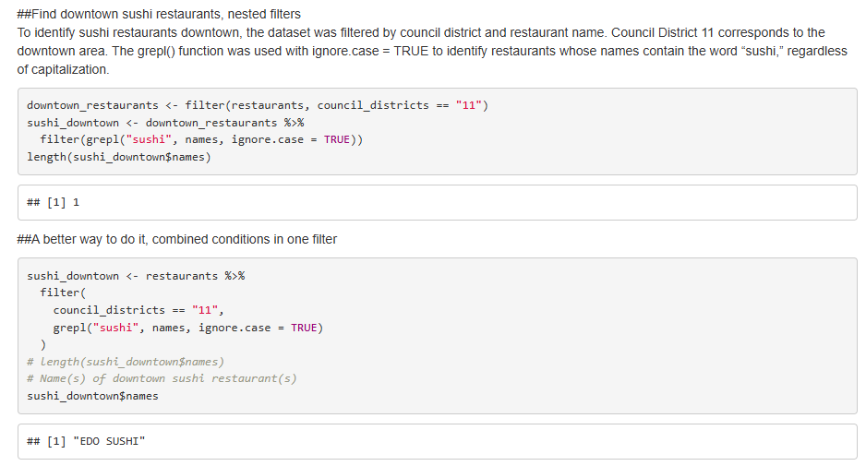
Filter the dataframe for just downtown restaurants (Council District 11).

Slide 6
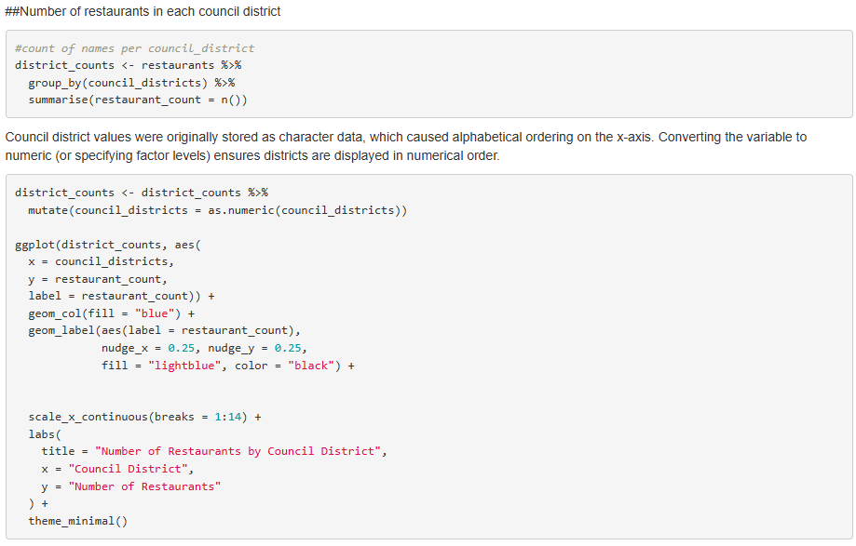
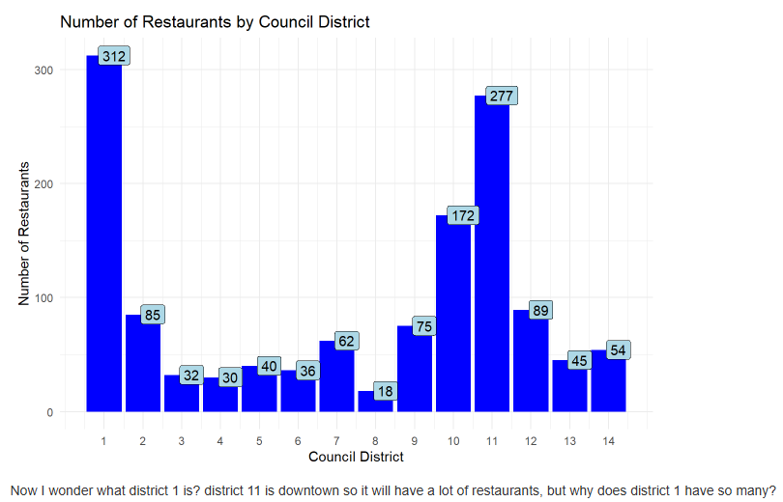
Make a barplot of the estimated number of restaurants (Sushi or otherwise) in each council.

Slide 7
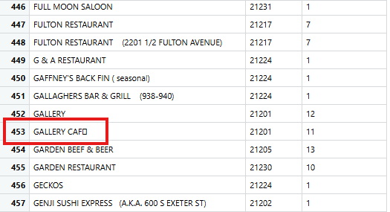
Takeaways and Questions
What do we do about data that is not clean, in an unpredicted way? Like this:
Searching “sushi” → cannot find “sush1” , “sushee” ,“sooshee” , “King’s Sashimi Palace”
Searching “café” → cannot find GALLERY CAF0

Slide 8
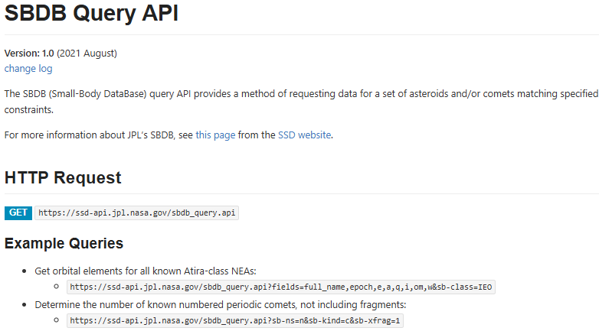
https://ssd-api.jpl.nasa.gov/doc/sbdb_query.html

Slide 9
Clearly describe the data and the columns / variables that are of interest to your presentation.
Field Name | Type | Description | Meaning | Example
rms | number | normalized RMS of the observation fit in the OD | The RMS of the orbit of a small body measures how well the computed orbit fits the observational data.Lower RMS values indicate a better orbit fit. | 0.43382
last_obs | string | date of the last observation used in the orbit (YYYY-MM-DD or YYYY-??-?? when only the year is known) | For calculating the orbit prediction, when was the last time it was updated with data from an observed orbit? | 11/7/2025
spkid | string | primary SPK-ID | An SPK ID (Spacecraft and Planet Kernel Identification number) is a unique integer code assigned by NASA to identify specific solar system bodies, spacecraft, or instruments within the SPICE system. | 20000015
data_arc | number | number of days spanned by the observations used in the orbit determination | How long have we been observing the orbit of the object, to use real data for modeling the predicted orbit? | 80789
n_obs_used | number | total number of observations of all types used in the orbit | How many times has the orbit been observed, the number of samples we have to use in the model? | 9764

Slide 10
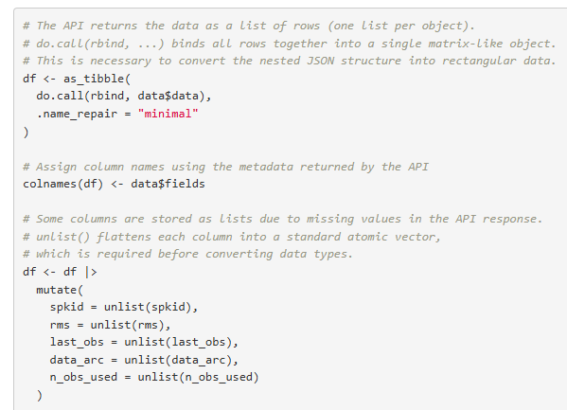
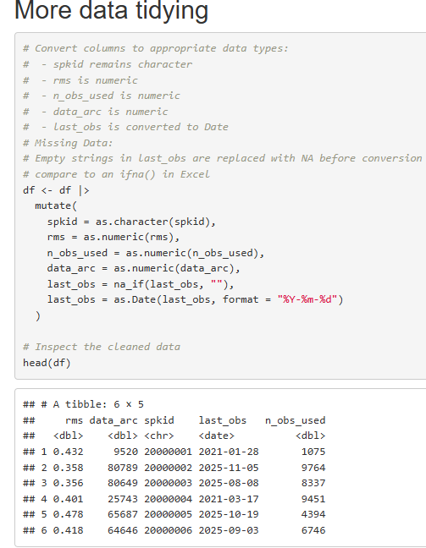
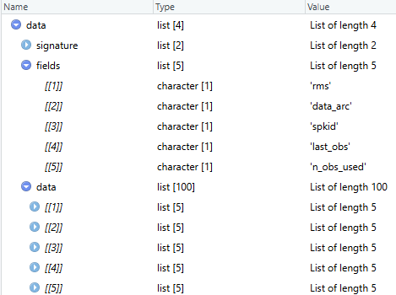
Tidy Data
Each variable is a column
Each observation is a row
Each cell is a single value
before
after

Slide 11
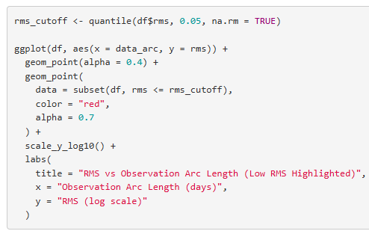
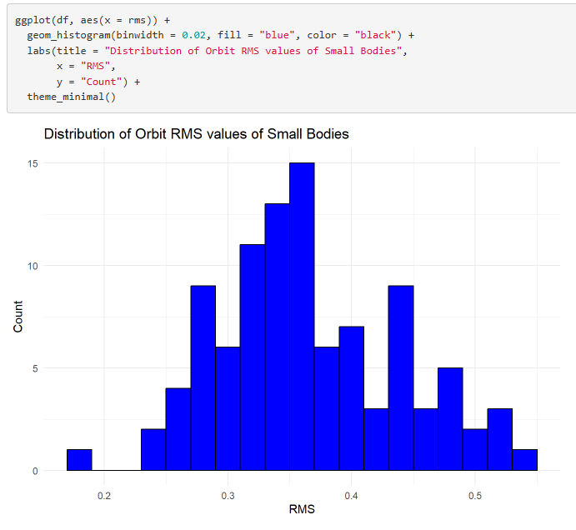
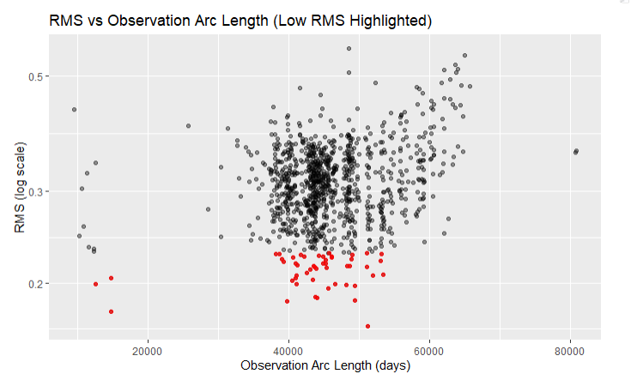
Distribution of Orbit RMS
Red → low uncertainty in orbit model

Slide 12
#Full code here:
https://github.com/Iwestlauer/doing_data_science/blob/main/Unit%204%20Tidyverse/Web_Scraping.Rmd
#Abridged code shown
#NASA API Exploratory Data Analysis
library(httr2) # r library for making http requests to an API
library(tidyverse) # tidyverse includes tibble, dplyr, ggplot2, tidyr, readr, stringr, etc.
# Make an API GET request to sbdb_query.api
fields <- "rms,data_arc,spkid,last_obs,n_obs_used"
limit <- 1000 # limit the number of records returned
resp <- request("https://ssd-api.jpl.nasa.gov/sbdb_query.api") |>
req_url_query(
fields = fields,
limit = limit) |>
# Prevent the request from stopping execution on HTTP errors
req_error(is_error = function(resp) FALSE) |>
req_perform()
# Tidy the data
data <- resp_body_json(resp) # Parse the JSON response into an R list
# The API returns the data as a list of rows (one list per object).
# do.call(rbind, ...) binds all rows together into a single matrix-like object.
# This is necessary to convert the nested JSON structure into rectangular data.
df <- as_tibble(
do.call(rbind, data$data),
.name_repair = "minimal"
)
colnames(df) <- data$fields # Assign column names using the metadata returned by the API
# Some columns are stored as lists due to missing values in the API response.
# unlist() flattens each column into a standard atomic vector,
df <- df |>
mutate(
spkid = unlist(spkid),
rms = unlist(rms),
last_obs = unlist(last_obs),
data_arc = unlist(data_arc),
n_obs_used = unlist(n_obs_used)
)
# Convert columns to appropriate data types:
# Missing Data: Empty strings in last_obs are replaced with NA before conversion
df <- df |>
mutate(
spkid = as.character(spkid),
rms = as.numeric(rms),
n_obs_used = as.numeric(n_obs_used),
data_arc = as.numeric(data_arc),
last_obs = na_if(last_obs, ""),
last_obs = as.Date(last_obs, format = "%Y-%m-%d")
)
## Plot Distribution of Orbit RMS
ggplot(df, aes(x = rms)) +
geom_histogram(binwidth = 0.02, fill = "blue", color = "black") +
labs(title = "Distribution of Orbit RMS values of Small Bodies",
x = "RMS",
y = "Count") +
theme_minimal()
## Plot observation arc length vs RMS
rms_cutoff <- quantile(df$rms, 0.05, na.rm = TRUE)
ggplot(df, aes(x = data_arc, y = rms)) +
geom_point(alpha = 0.4) +
geom_point(
data = subset(df, rms <= rms_cutoff),
color = "red",
alpha = 0.7
) +
scale_y_log10() +
labs(
title = "RMS vs Observation Arc Length (Low RMS Highlighted)",
x = "Observation Arc Length (days)",
y = "RMS (log scale)"
)

Slide 13
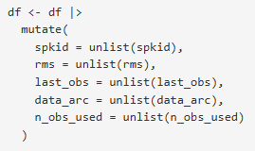
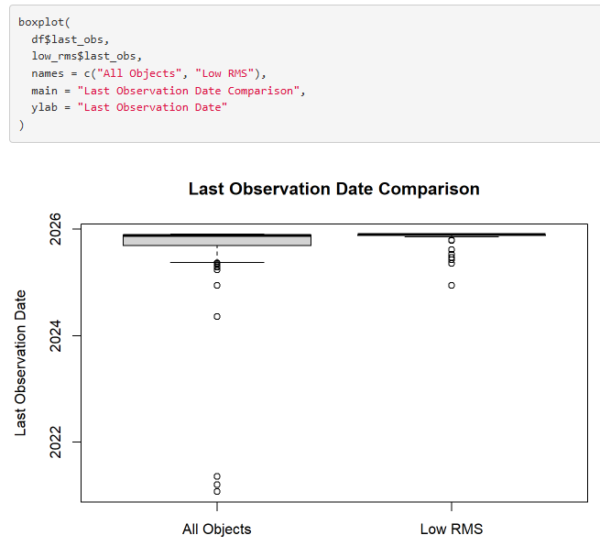
Obstacles
Had to use unlist()
Some columns are stored as lists due to missing values in the API response. unlist() flattens each column into a standard atomic vector, required before converting data types.
The httr url had fields=field1,field2 which cannot have any spaces between the field names, or you will get a 400 error
If you don’t put a limit on your request and it’s just too much, you will get a 400 error
I couldn’t get usable data from sbdb api, had to use sbdb query api
The date field from the json was a string, but I had to convert it to a date, as.Date() is important to be able to plot values versus date, in order from earliest to latest
Tried a boxplot but didn’t know how to interpret it

Slide 14
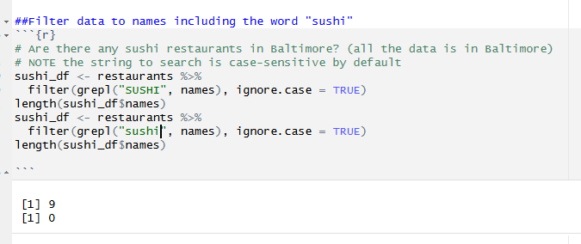
Questions
Gather Spread and Separate: How does it know to separate based on the delimiting character?
API key: How come I registered for an API key for the NASA db, but didn’t have to use it to make a successful GET request?
grep: Why does ignore.case not work as expected here?

Slide 15
How do I write a hypothesis when I’m looking for a correlation between two variables?

Slide 16
Links
https://ssd-api.jpl.nasa.gov/doc/sbdb_query.html
https://github.com/Iwestlauer/doing_data_science/tree/main/Unit%204%20Tidyverse

